Slide 1
Cost of Living Snapshot: Urban vs Rural Africa

Slide 2
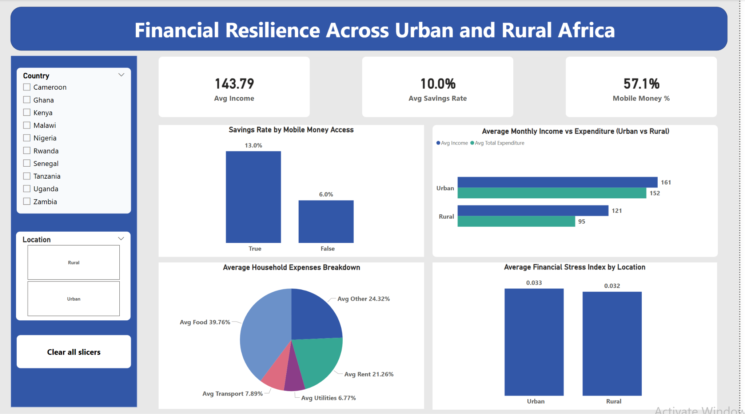
Data Summary + Visual Snapshot
5,786 homes in 9 African countries
Information about people, income, spending, savings, and access
Financial Stress Index (0–1 scale) to measure risk
Key Highlights:
City homes earn more money (161 vs 121 USD on average)
Mobile money users save more than double (13% vs 6%)
Food makes up about 40% of what families spend on average.

Slide 3
Key Insights & Implications for Financial Institution
Insight 1: Urban Cost Pressure
People in cities earn more money, but they also spend a lot. This leaves them with less to save.
Implication: Earning more won't help families be financially stable if they do not manage their costs.
Insight 2: Food-Dominated Budgets
Almost 40% of household spending goes on food. This means they have little extra money.
Implication: Families, especially in rural areas, face risks if food prices rise.
Insight 3: Mobile Money & Savings
Households that use mobile money save much more—13% compared to 6%.
Implication: Improving access to mobile financial services could help families save more and be more stable.
Boosting digital financial access along with income support can help African families be more financially secure.

